Slide 1

Obstacle detection and distance estimation for visually impaired people.
Group: 03
Raj Bhensadadia (20150101011) Bansi Gajera (201501028) Dhwani Mehta (201501054) Kanan Vyas (201501121)
Supervised by: Prof. Mehul Raval

Slide 2
Problem Statement
Real Time Obstacle Detection and position estimation, with the goal of informing the visually impaired users about the surrounding obstacles and their spatial position using navigations.
Overview:
Obstacle detection
Proximity alert based on distance estimation
Navigation alert

Slide 3
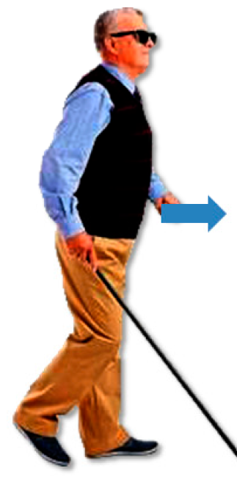
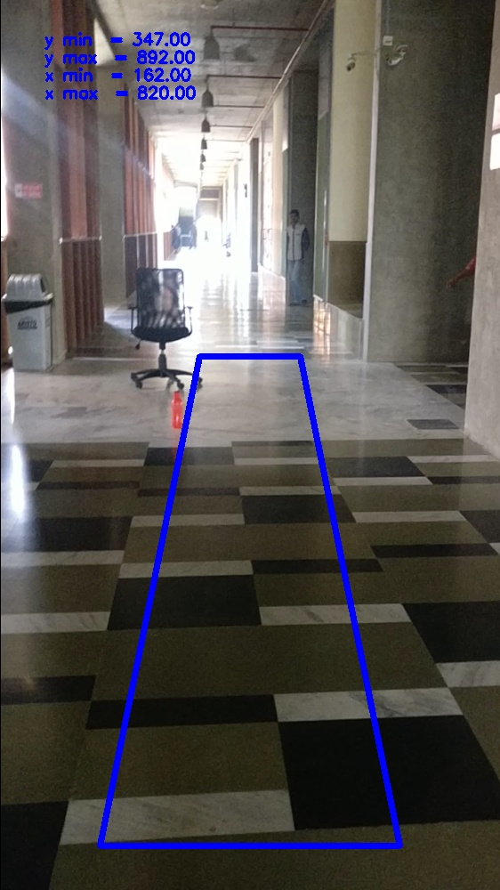
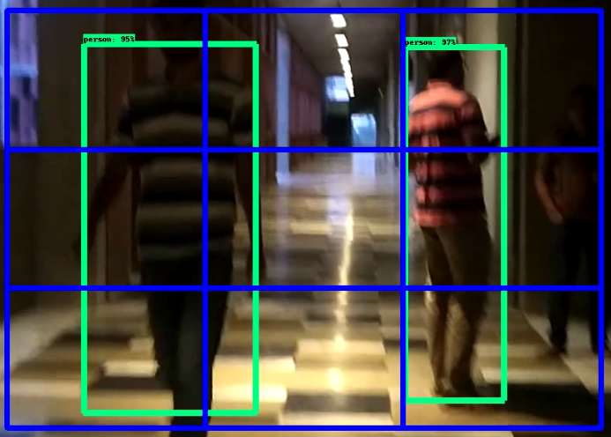
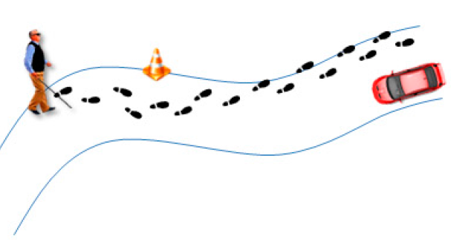
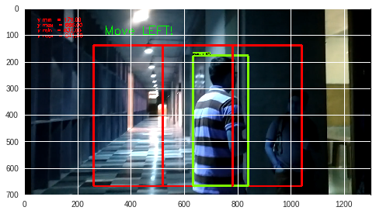
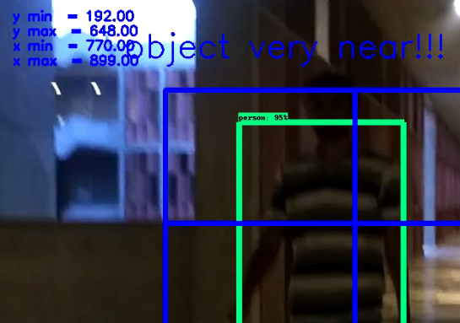
Block Diagram
Defining Proximity
Obstacle detection and recognition
Navigations
Direction of Object’s motion / placement
Distance of the object - Near / Far ?
Safe navigations

Slide 4
Obstacle detection Methods
Single Shot Detector achieves a good balance between speed and accuracy. SSD runs a convolutional network on input image only once and calculates a feature map. Now, we run a small 3×3 sized convolutional kernel on this feature map to predict the bounding boxes and classification probability.
Faster R-CNN uses Regional Proportional Network to generate region of interests. It also uses different size of anchor boxes and aspect ratio at each location on which RPN predicts the probability of being background or foreground.RPN gives out bounding boxes of various sizes with the corresponding probabilities of each class. Then bounding box regression is done for localization of object.
Faster R-CNN is more accurate than SSD. But for the speed concern, SSD is faster.

Slide 5
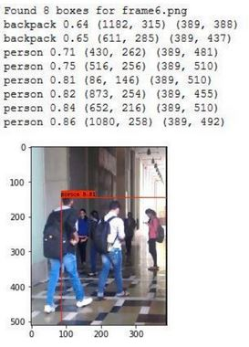
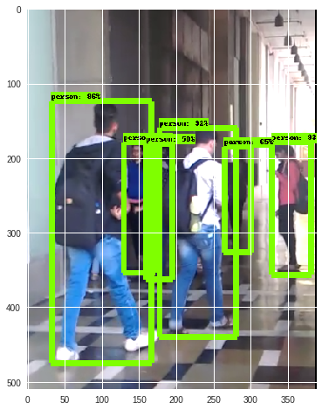
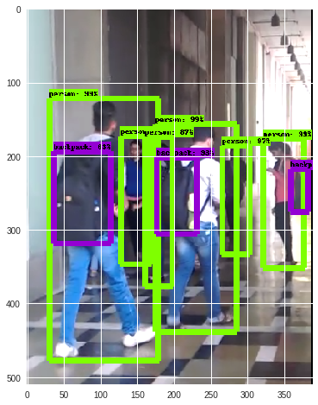
Obstacle detection
Pre-trained models are used for obstacle detection.
1. YOLO 2. SSD 3. Faster R-CNN

Slide 6
Proximity defining Algorithm
Define a region of interest which is in proximity of the camera.(left,right,front)
If the object comes under the region of interest, deploy object detection algorithm within that region.
Estimate detection class and detection score of the respective object in the defined region.
If the detection score is greater than or equal to a particular threshold ( detection threshold is taken to be 70%), consider the object
This way the object will be tracked when it comes near to the user and alerts the user.

Slide 7
Path Navigation
Left - Right Navigation
Divide the region of interest into 3 segments vertically (left, center and right)
When the coordinates of object is in the right segment, it will be navigated to Left and when the coordinates of object is in the left segment, it will be navigated to Right.

Slide 8
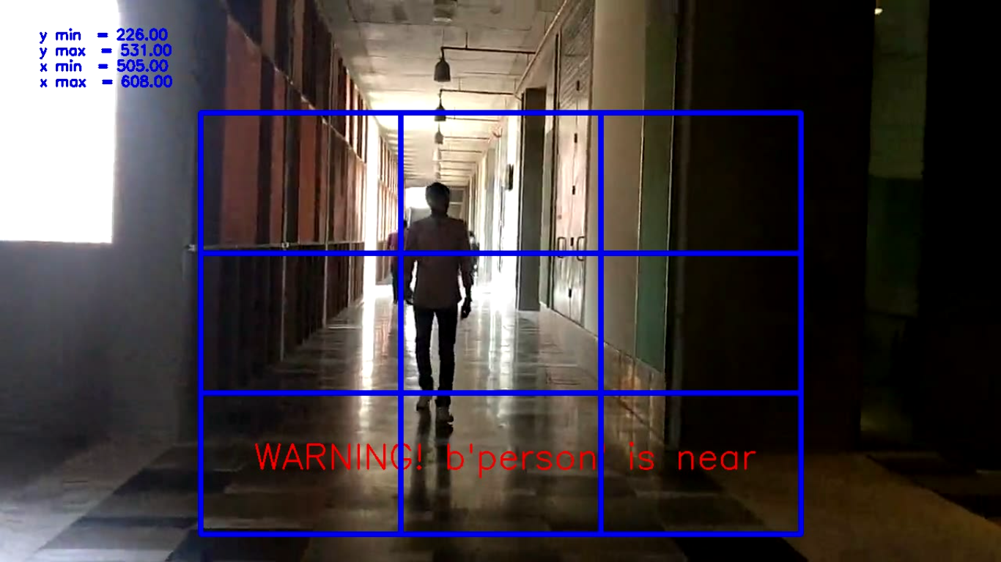
Path Navigation
II. Distance Navigation A. Divide the region into 2 segments horizontally (far and near) B. When the coordinates of the object is in far segment, user will be navigated about the object’s distance as far and when the object’s coordinates are in near segment, user will get warned about the object’s distance as near and proximity alert will be generated.

Slide 9
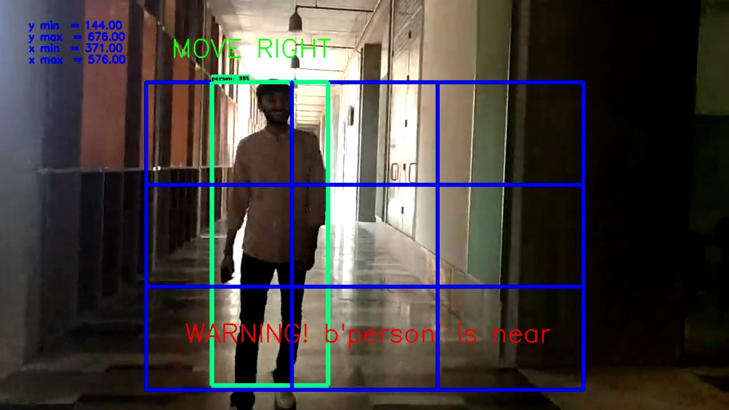
Results

Slide 10
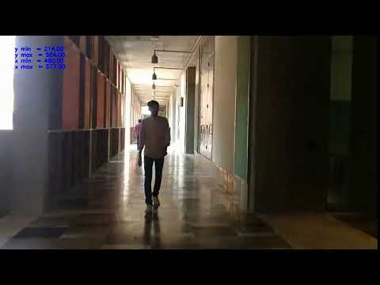
Results

Slide 11
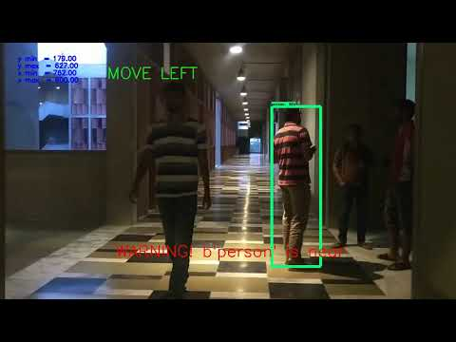
Results

Slide 12
Future Work
Optimization of Navigation algorithm.
To be able to classify multiple objects at same proximity distinctly and definitely and invoke motion in the resultant direction to avoid obstacles on the way.
Real time implementation with API development.
Processing of FPS: In a real time implementation we need to take care about how much time it will take to process one frame.

Slide 13
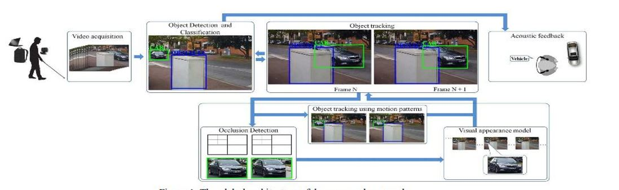
Assignment-2
Article: An automatic cognition system dedicated to blind and visually impaired people.
Mocanu, Bogdan, Ruxandra Tapu, and Titus B. Zaharia. "Seeing Without Sight-An Automatic Cognition System Dedicated to Blind and Visually Impaired People." ICCV Workshops. 2017.

Slide 14
Assignment Implementation
The paper proposed algorithm for object detection and tracking system for acoustic warning and sudden movements that can help visually impaired people.
For the object tracking it uses subsequent frames, hence the same method was used for optimizing the Navigation algorithm.
Navigation result of previous result has been also stored and if there is a direct change in current navigation, it will not show the result.
Implementation of YOLO for the object detection was also the part of the assignment.

Slide 15
References
[1] Godard, Clément, Oisin Mac Aodha, and Gabriel J. Brostow. "Unsupervised monocular depth estimation with left-right consistency." CVPR. Vol. 2. No. 6. 2017.
[2] Wedel, Andreas, et al. "Real time depth estimation and obstacle detection from monocular video." Joint Pattern Recognition Symposium. Springer, Berlin, Heidelberg, 2006.
[3] Mohan, Dineesh and Dr. A. Ranjith Ram. “A Review on Depth Estimation for Computer Vision Applications.”, positions 4.11 (2015).
[4] Rodríguez, Alberto, et al. "Assisting the visually impaired: obstacle detection and warning system by acoustic feedback." Sensors 12.12 (2012): 17476-17496.
[5] Tapu, Ruxandra, et al. "A smartphone-based obstacle detection and classification system for assisting visually impaired people." Proceedings of the IEEE International Conference on Computer Vision Workshops. 2013.

Slide 16
Thank You

